Slide 1
Convolutional Neural Networks: computer vision
Luke

Slide 2
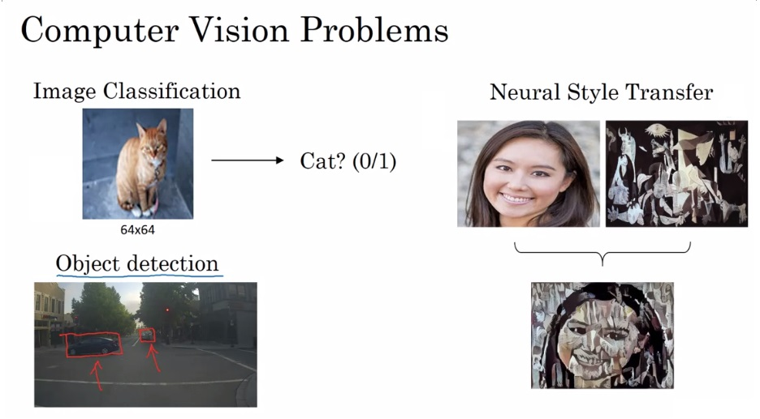
How do computers see?

Slide 3
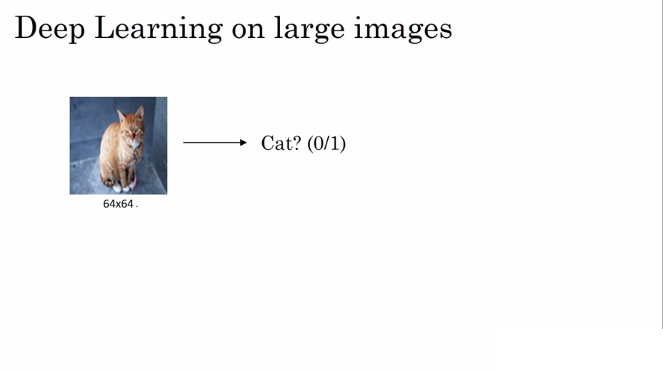
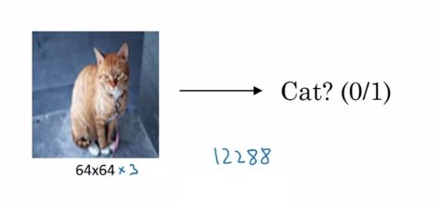
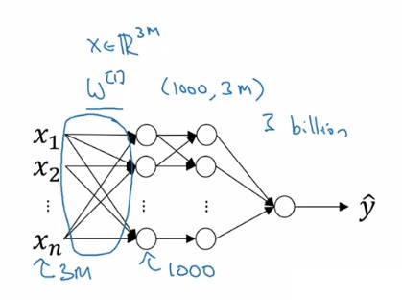
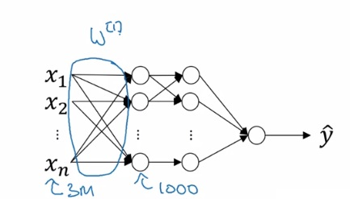
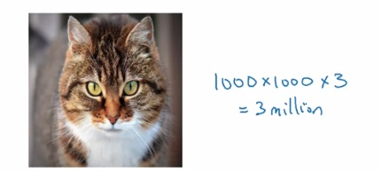
quality pictures = big input = overfit = too expensive

Slide 4
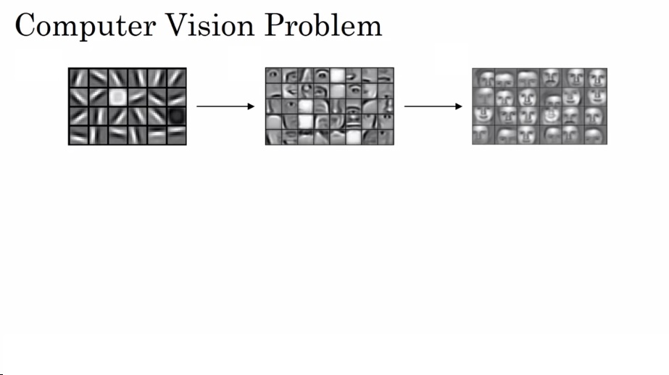
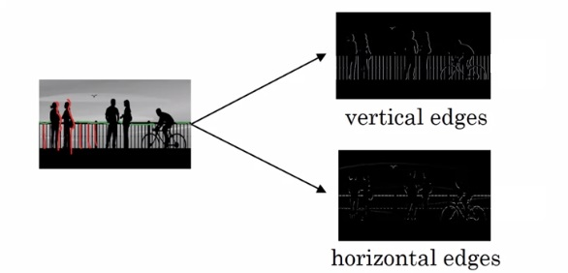
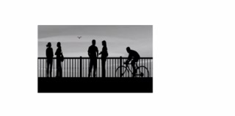
What is an edge

Slide 5
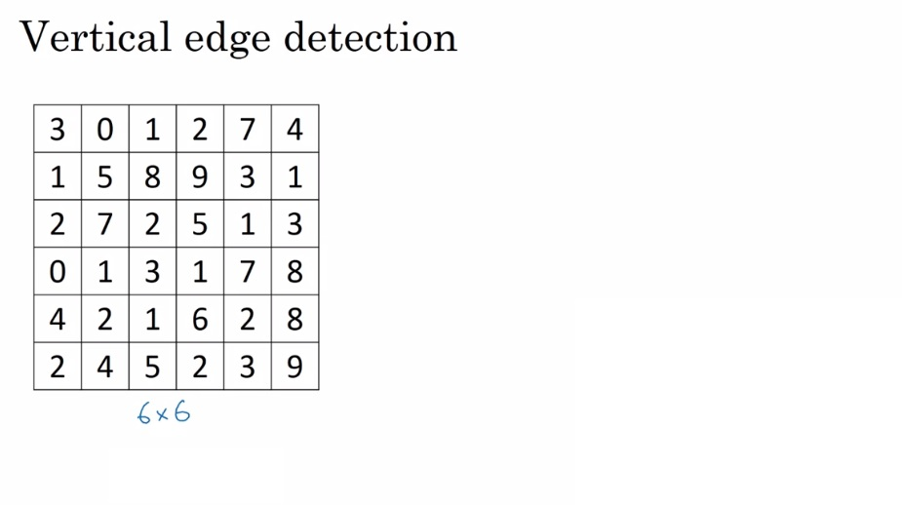
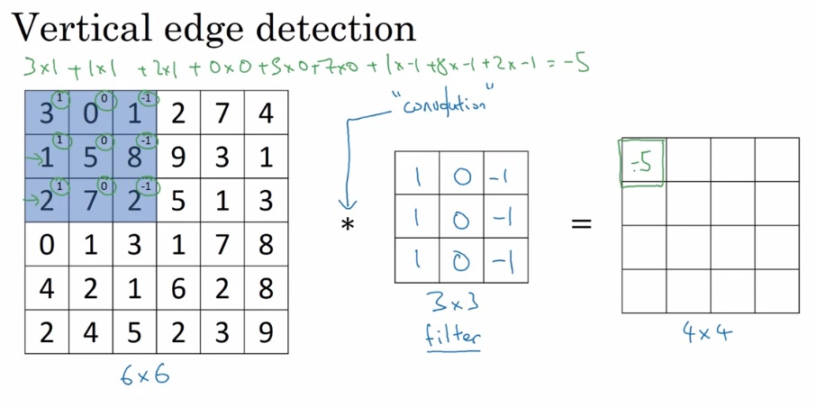
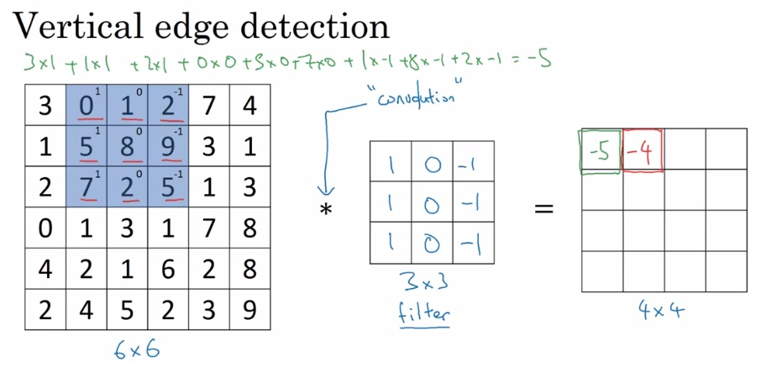
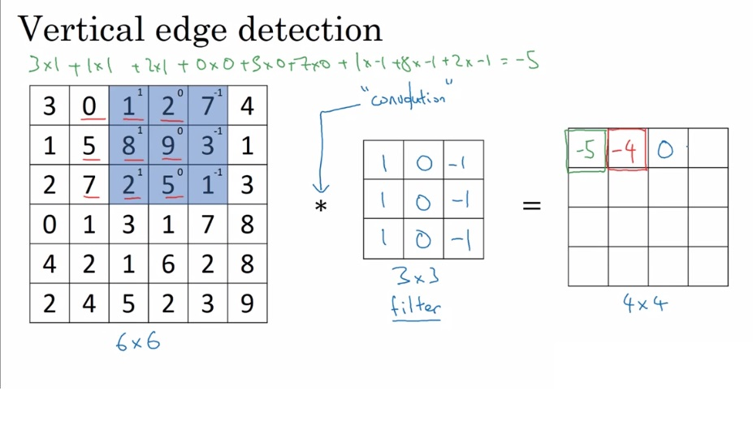
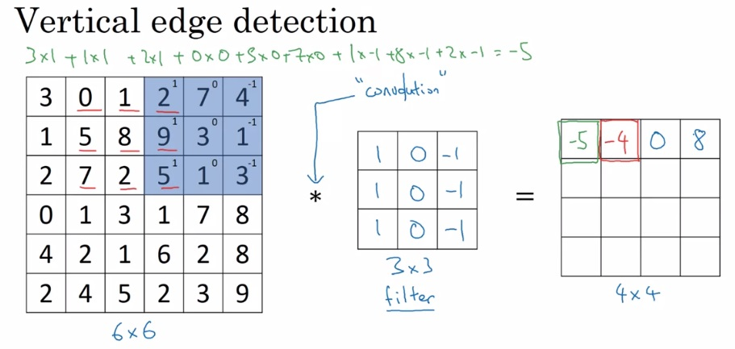
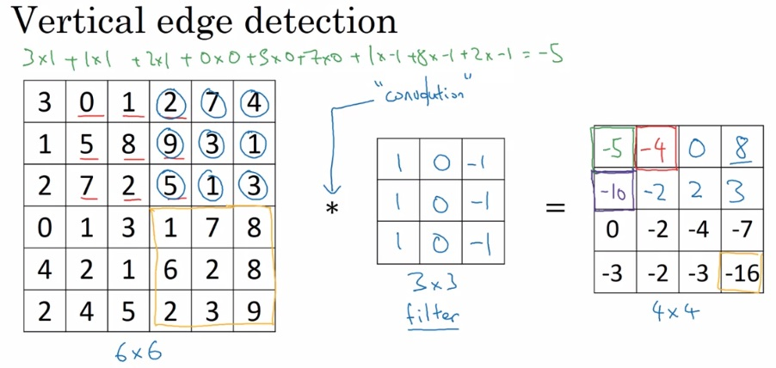
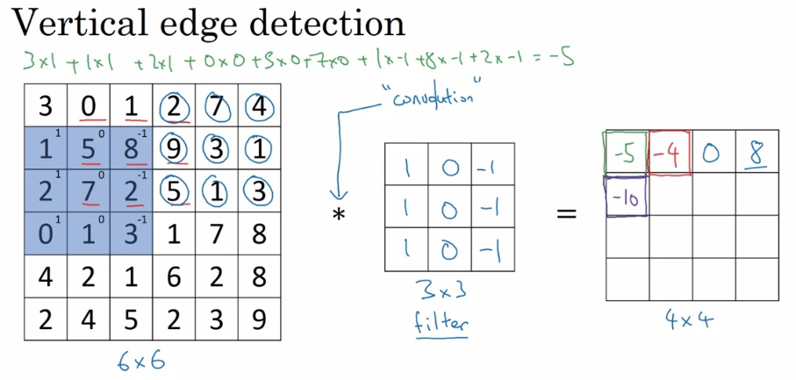
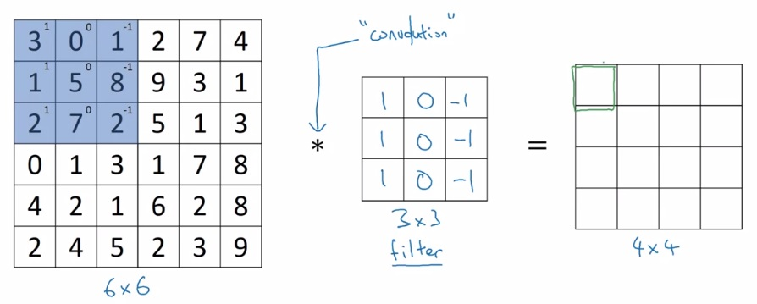
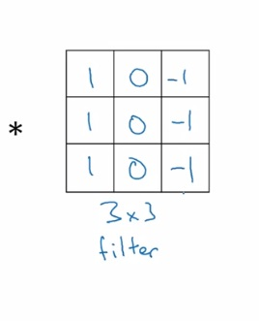
Enter the convolution
Also called a kernel
grayscale, no RGB channels
So we’ve compressed the matrix on the left via the filter,
yielding the matrix on the right. Images are just matrices

Slide 6
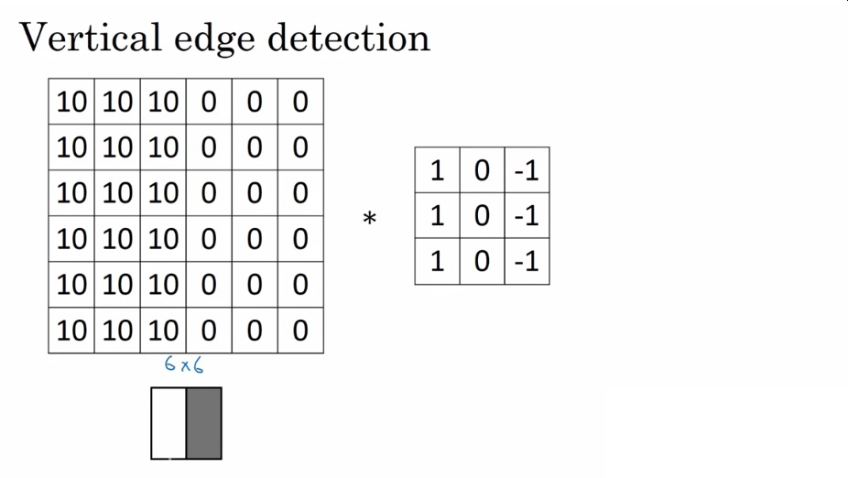
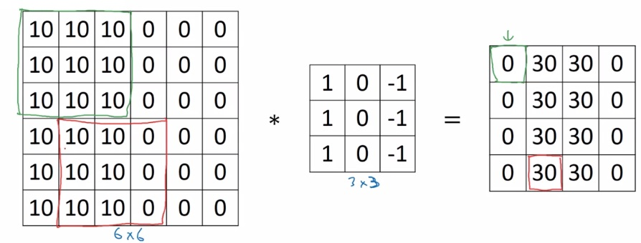
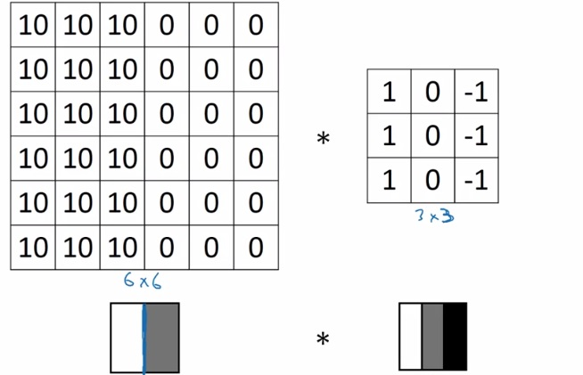
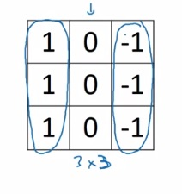
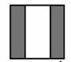
What are filters doing?
Output simply saying, “YO! There’s a vertical edge in the middle of the input!”

Slide 7
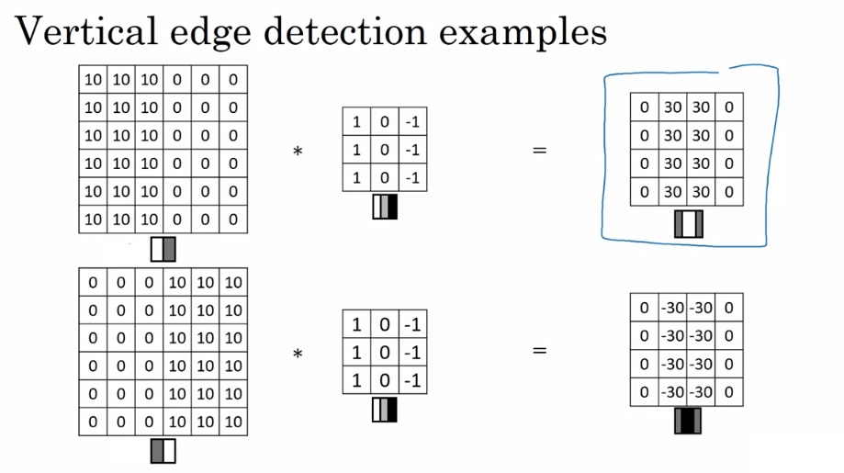
More edging
Bright to dark
Vs
Dark to bright

Slide 8
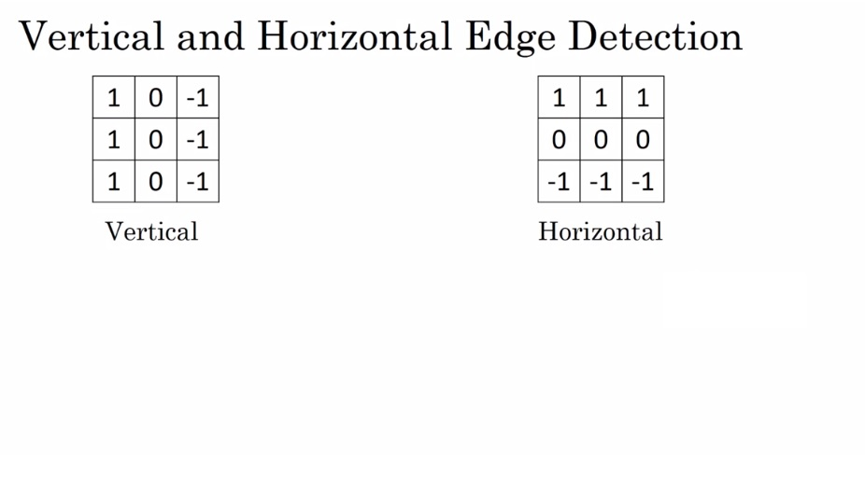
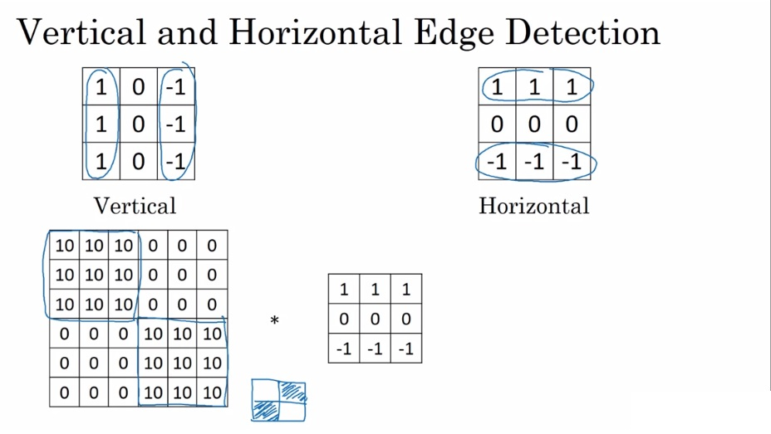
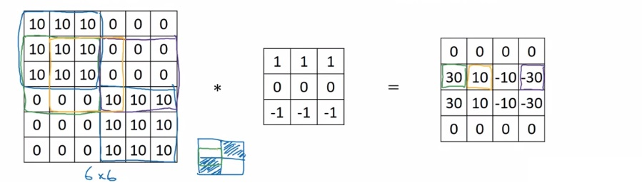
All the edges, baby

Slide 9
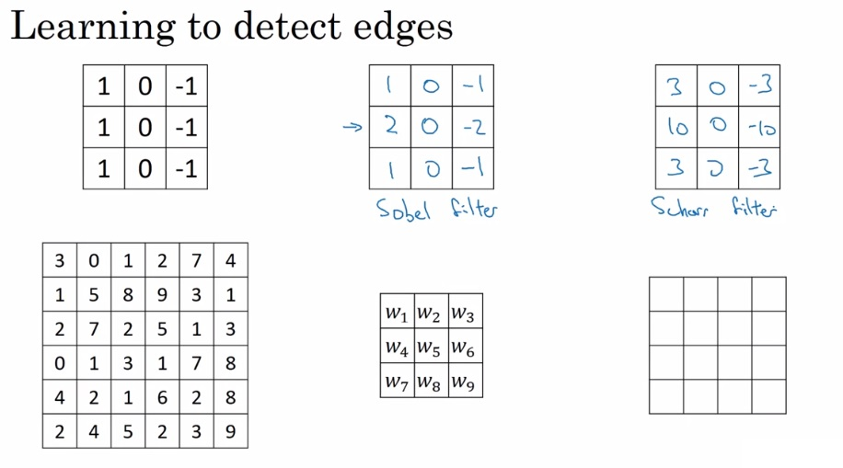
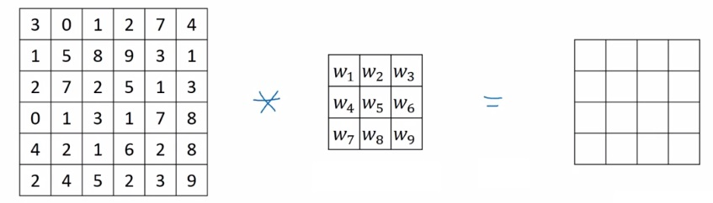
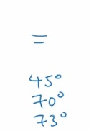
Historical filters

Slide 10
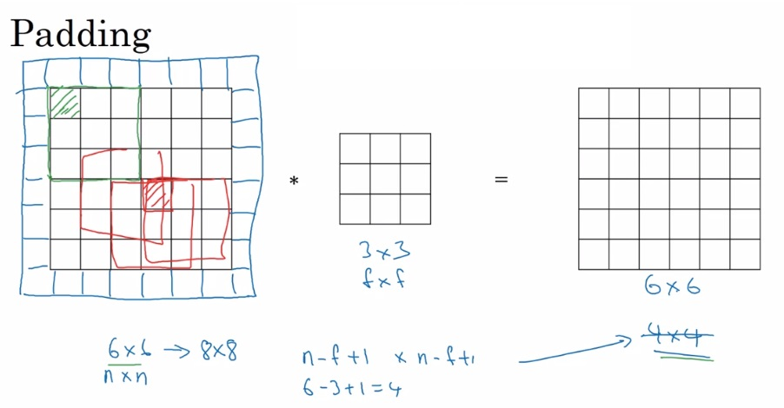
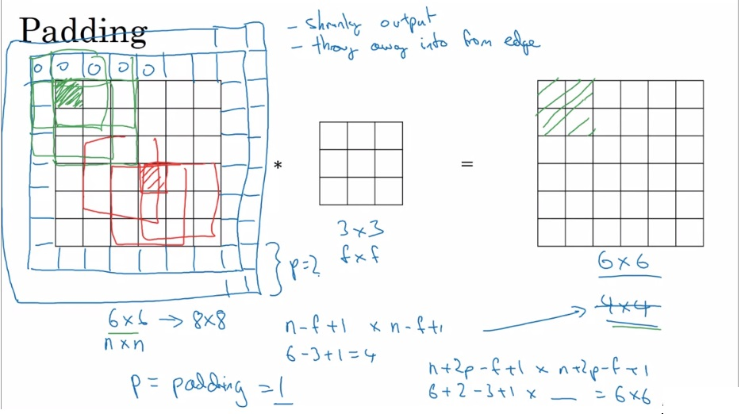
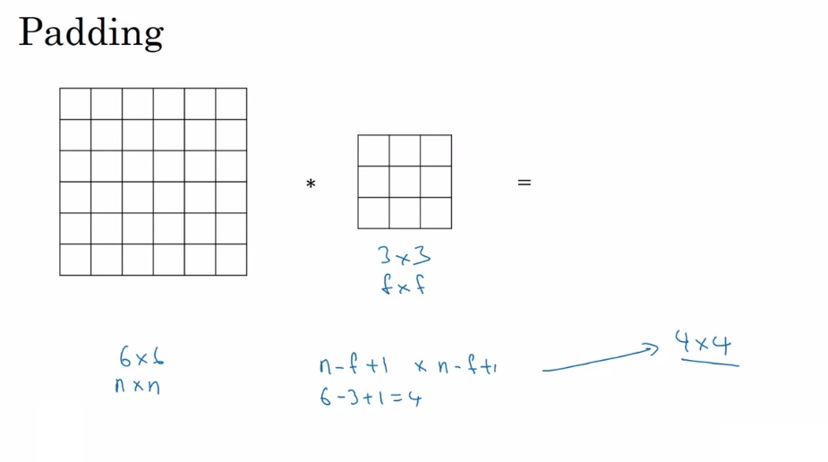
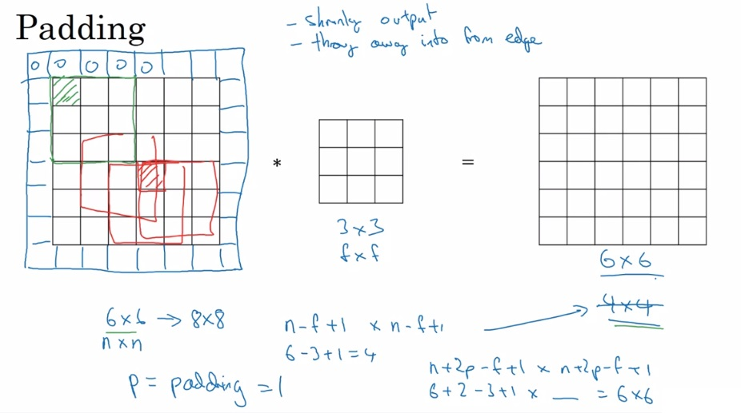
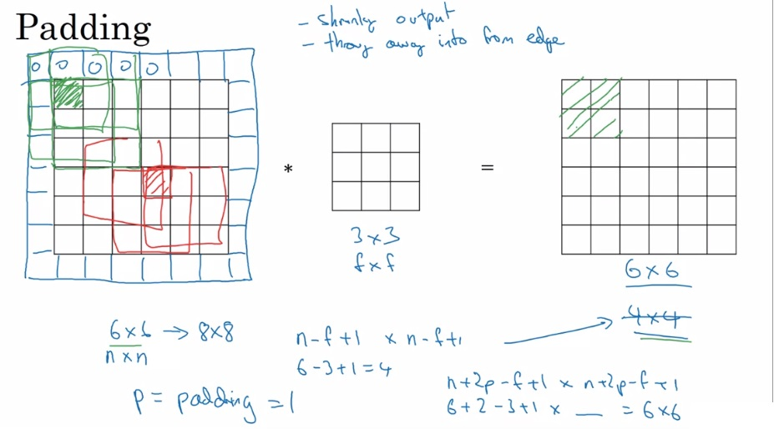
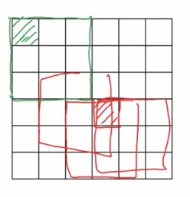
How do we go deep?
What are some problems with this?
Output shrinks very quickly
Throwing away information

Slide 11
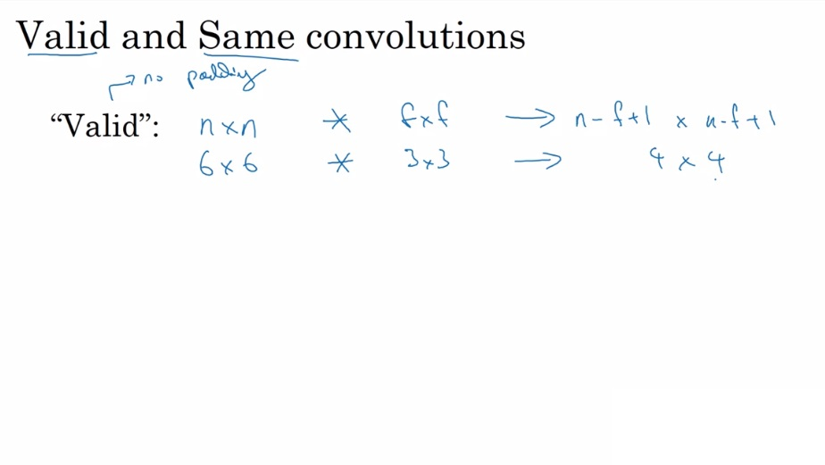
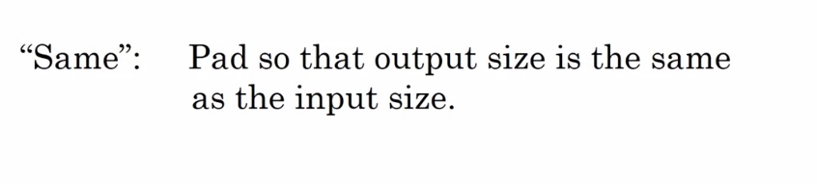
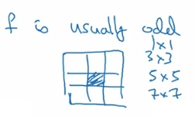
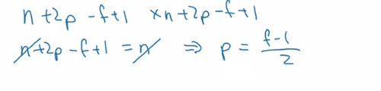
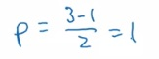
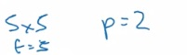
How to pad?
f is usually odd by convention
If f = even, asymmetric padding
Like to have a “central position”

Slide 12
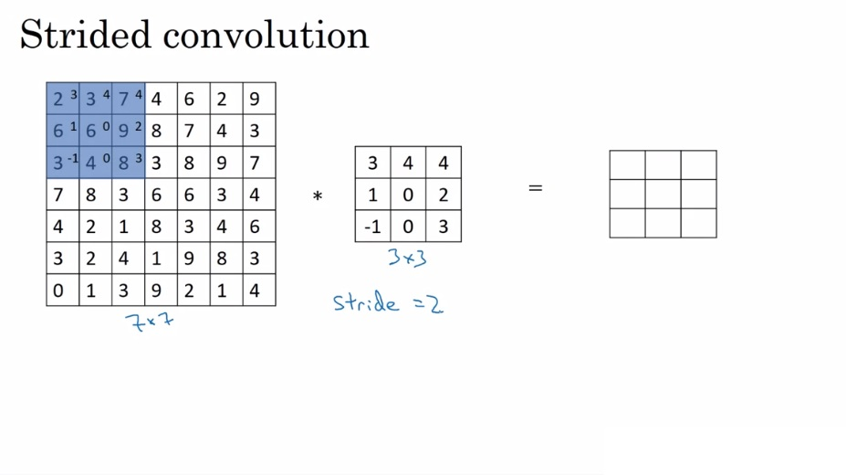
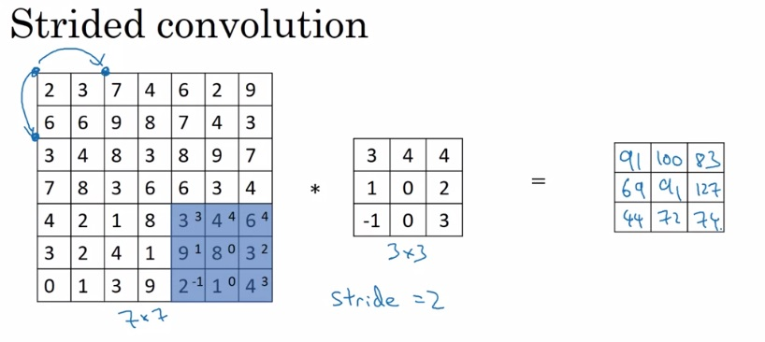
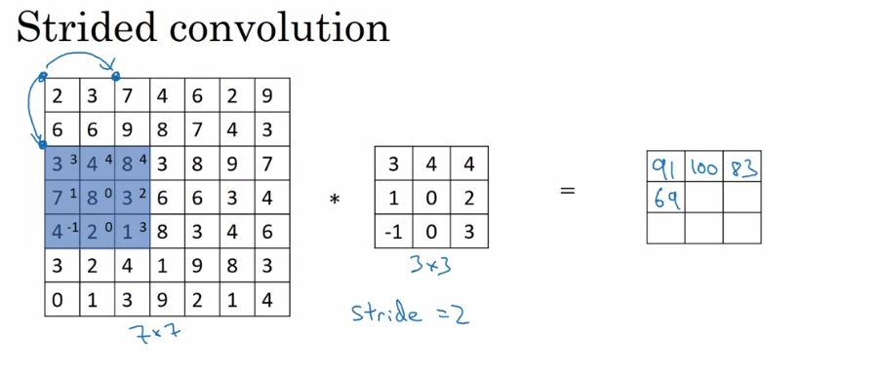
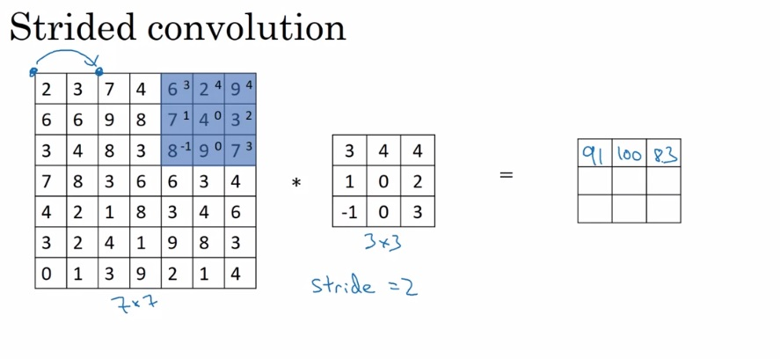
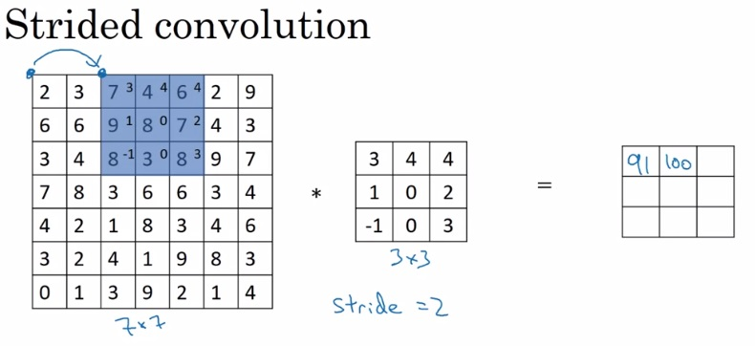
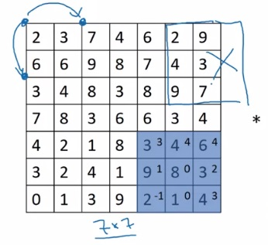
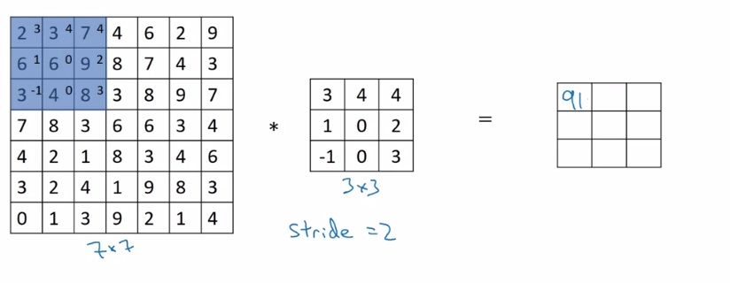
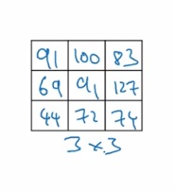




stride
By convention~

Slide 13

Notation thus far

Slide 14

So we’re actually doing cross correlation

Slide 15


Convolving a volume

Slide 16










Convolution on volume example

Slide 17




Stack filters, baby
We think of each filter as a “feature detector”
For example,
Vertical edges
Horizontal
Channel/depth
S = 1, p = 0

Slide 18










Layer of a cnn

Slide 19



Quick sanity check
Number of parameters unaffected by input size is the most important feature of CNNs

Slide 20













Our notation thus far
valid vs same

Slide 21









Full cnn example
On, say, image classification

Slide 22



pooling
The common intuition is that max pooling is a feature dector
Or an emphasizer of a certain feature…
… but I could find no explanation beyond this,
expect that it’s used widely in experiments
Fixed computation, no learnable parameters

Slide 23







Max pooling example
Max pooling performed independently for each channel

Slide 24



Average pooling and summary

Slide 25













Let’s build a cnn
6 filters
16 filters

Slide 26

Cnn summary

Slide 27


So why cnns anyway?

Slide 28





Why cnns?
“translation invariance”

Slide 29

finally

Slide 30
How do computers see?

Slide 31


Coarse to fine sampling scheme

